Slide 1
Community and Public Transportation Trends PPTA April 20, 2016

Slide 2
First Things First
Let’s Look at Where
We Stand Today

Slide 3
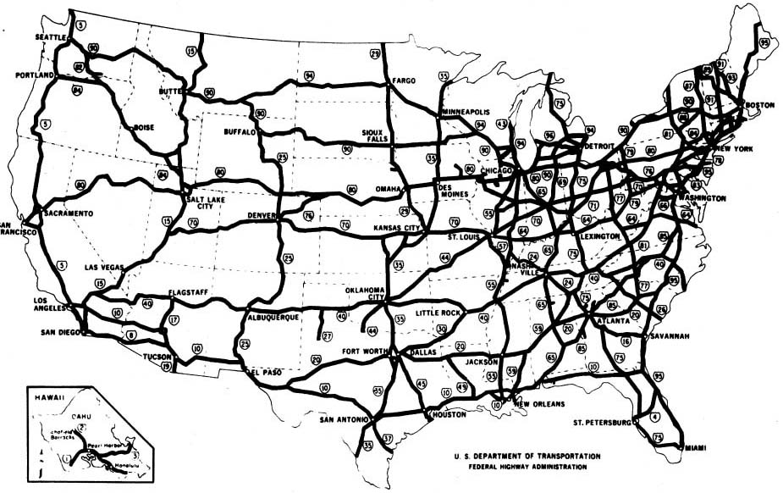
The End of an Era

Slide 4
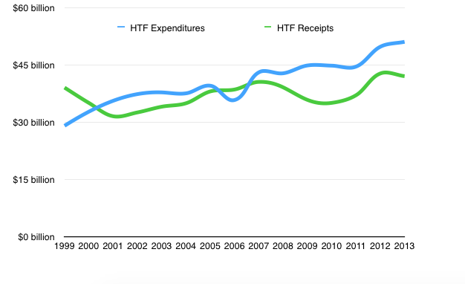
The Trust Fund Model is Broken
Gas Tax Unchanged Since 1993
Beginning with 2007, Expenditures Exceed Receipts
Congress Has Approved $75b in Trust Fund Transfusions

Slide 5
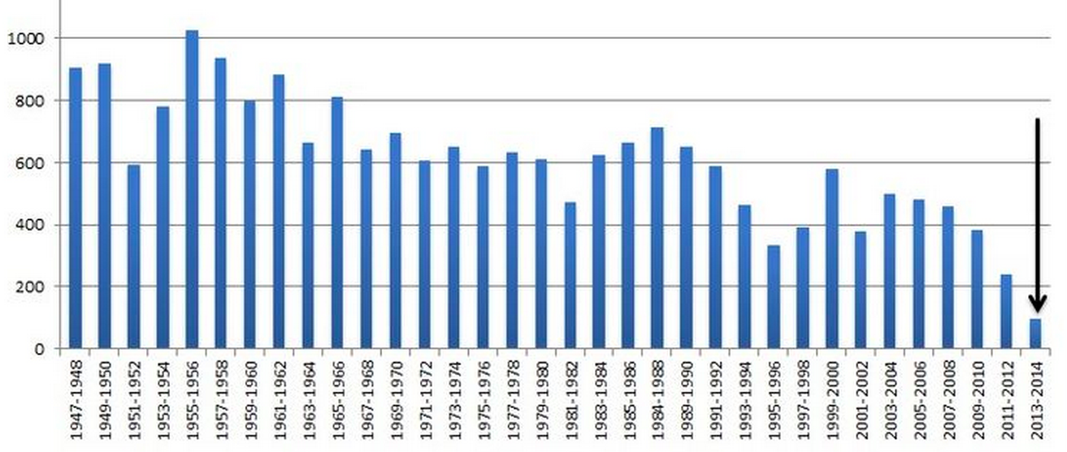
Congress: Unwilling to Assist

Slide 6
FAST Act: More Can Kicking
Modest, predictable growth
Helps with Bus Capital
Doesn’t solve sustainability issues
2020 = more challenging issues

Slide 7
The Future of Transit Will Be…
Customer and market driven
Technology and data driven
Competitive
Focused on efficiency
Outcome based
Seized by those unafraid of risk and change

Slide 8
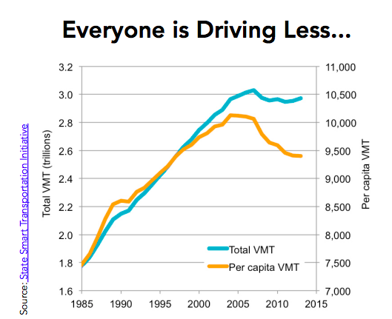
A Central Fact

Slide 9
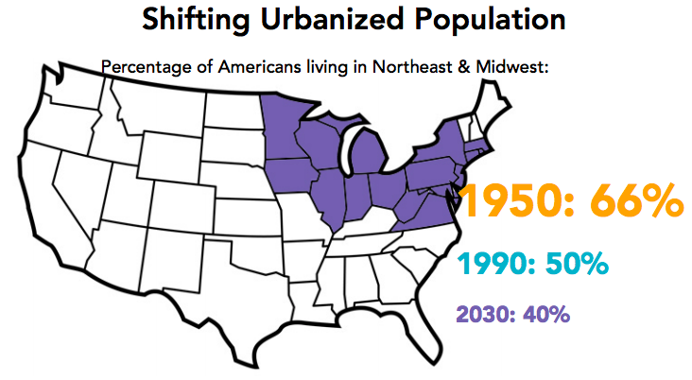
Urban Areas

Slide 10
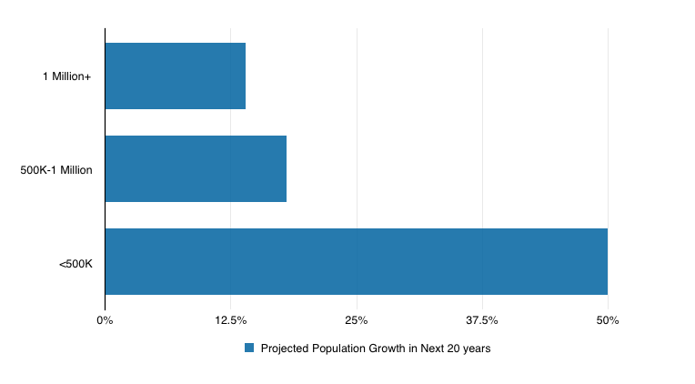
Urban Areas

Slide 11
Rural Areas

Slide 12
Young People

Slide 13
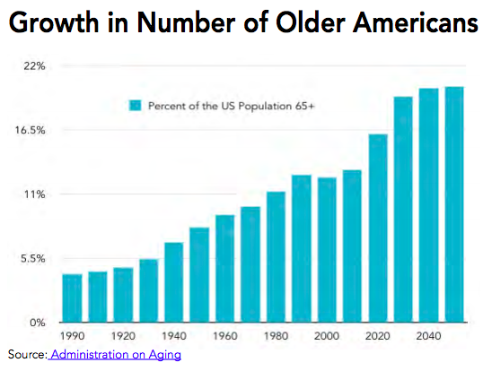
Older Adults

Slide 14
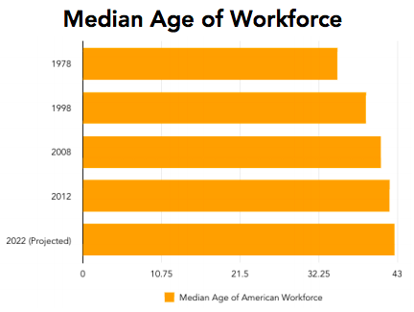
Employment & Workforce

Slide 15
People with Disabilities
1 in 5 Americans
has a disability
56.7 million people

Slide 16
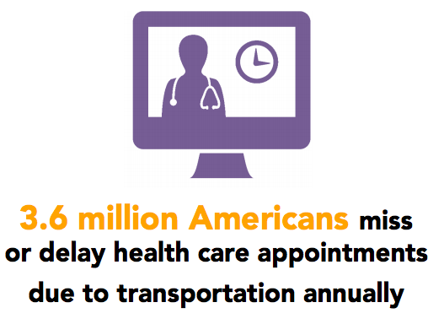
Health Care

Slide 17
Health Care

Slide 18
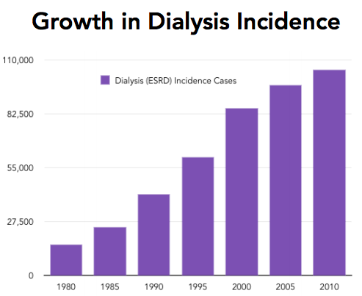
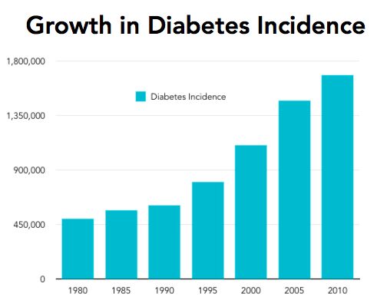
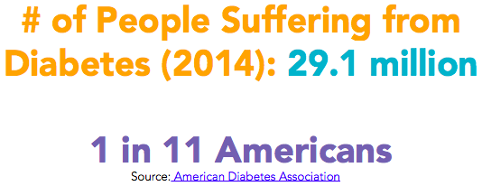
Health Care

Slide 19
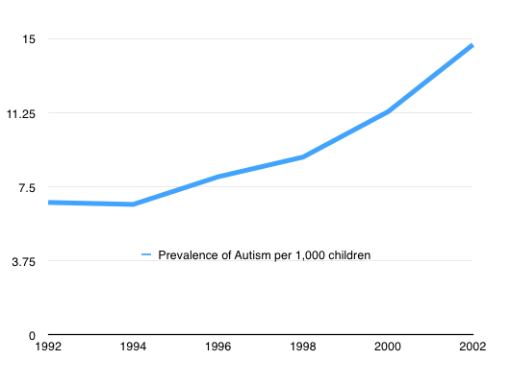
Health Care
Developmental Disabilities and the Autism Spectrum
⬇

Slide 20
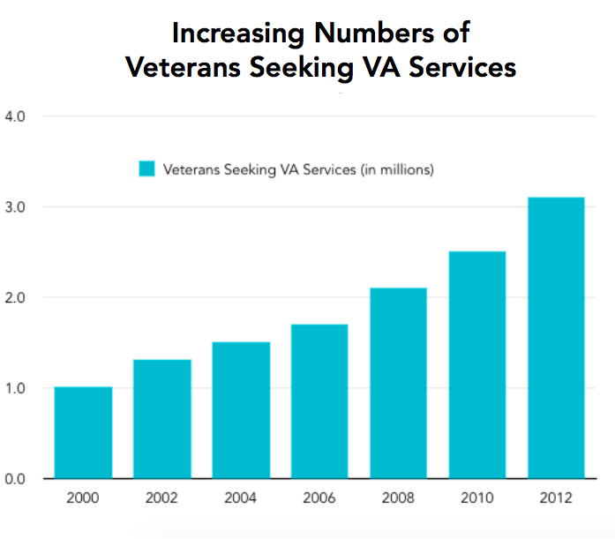
Health Care

Slide 21
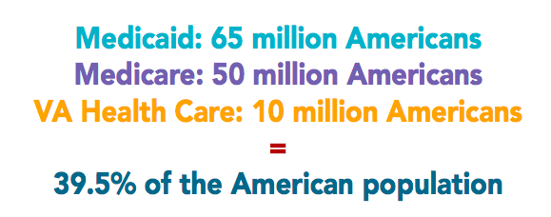
Health Care

Slide 22
Enter the Affordable Care Act
Extending Medicaid
Private Insurance Providers
Competition
Renewed Emphasis on High-Quality Service

Slide 23
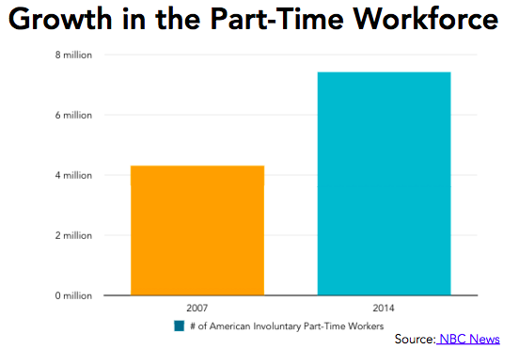
Employment & Workforce

Slide 24
The Changing Face of Transit

Slide 25
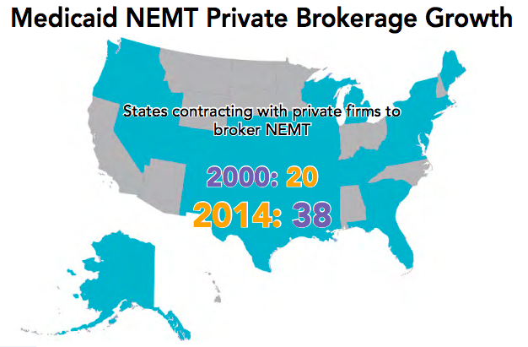
The Changing Face of Transit

Slide 26
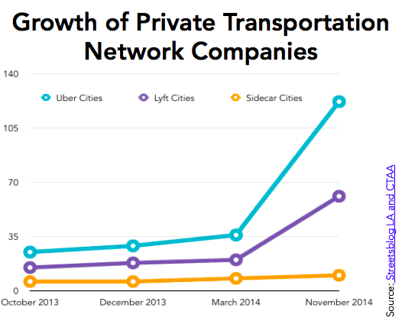
The Changing Face of Transit

Slide 27
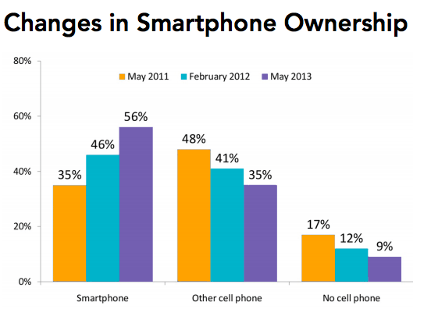
Technology

Slide 28
The Changing Face of Transit

Slide 29
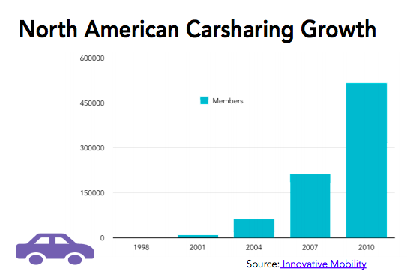
The Changing Face of Transit

Slide 30
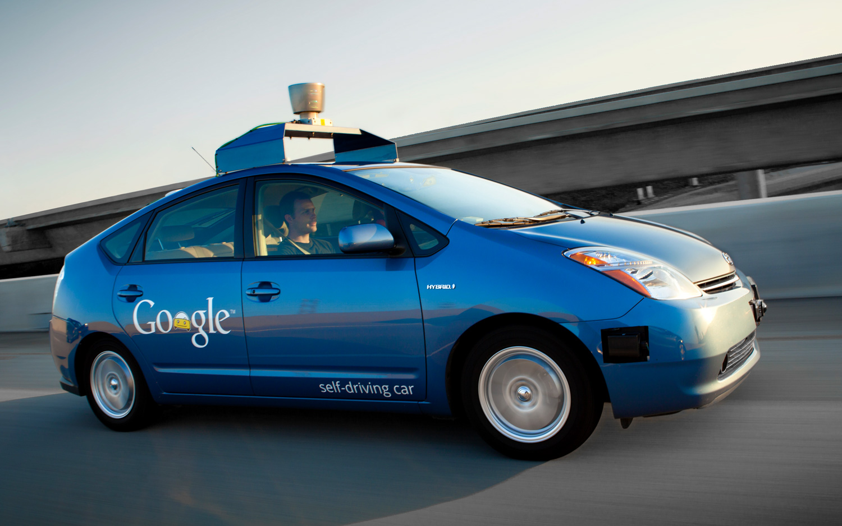
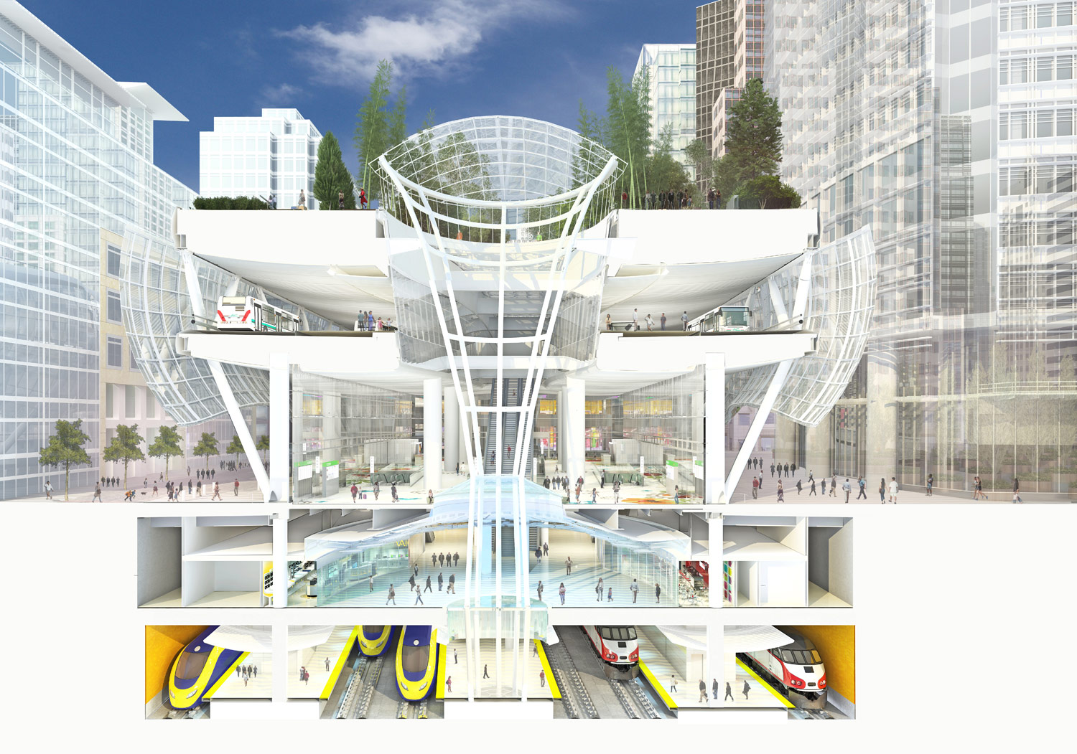
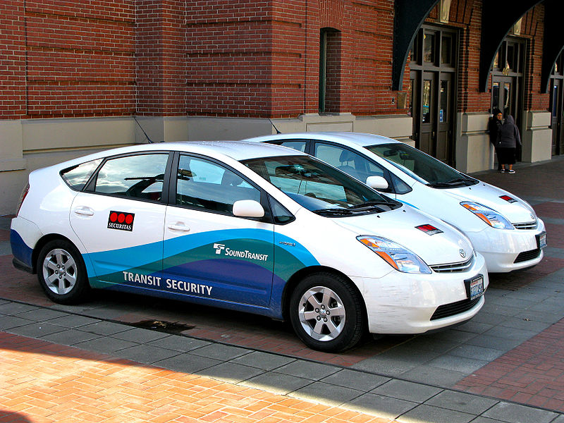
So What Comes Next?

Slide 31
Takeaways
Change
No One Size Fits All
Flexibility is Vital
Not Real Time — Now Time
Growth Markets = Toughest/Most Expensive
Partnerships Never More Important
Technology is the Equalizer
The Next Transportation Era is Taking Shape

Slide 32
How We Can Help You

Slide 33
Contact information:
bogren@ctaa.org
Twitter: @CTAAExecDir
www.ctaa.org
202.247.1921

